Slide 1
Large-scale Graph Mining with Spark
What I learned from mapping >15 million sites
Win Suen
PyGotham 2018

Slide 2
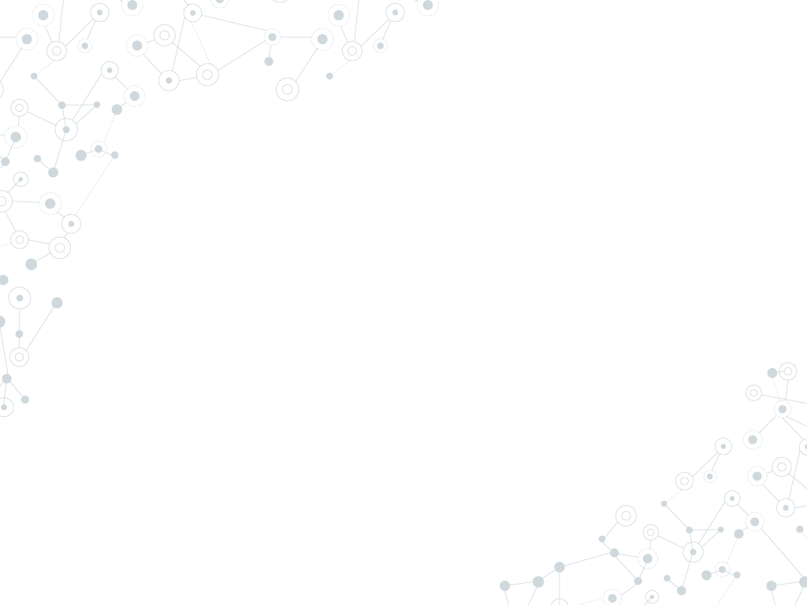

Hello!
I am Win Suen
Data Scientist @ AppNexus.
Avid hiker.
Reader of books and papers.

Slide 3
1.
Why graphs?

Slide 4
Why do I love graphs?
Graphs encode valuable, implicit information.
Many practical computing problems rely on graphs.
Graphs are fascinating!

Slide 5
Why do I love graphs?
Graphs encode valuable, implicit information.
Many practical computing problems rely on graphs.
Graphs are fascinating!
Graphs as problem-solving framework.

Slide 6
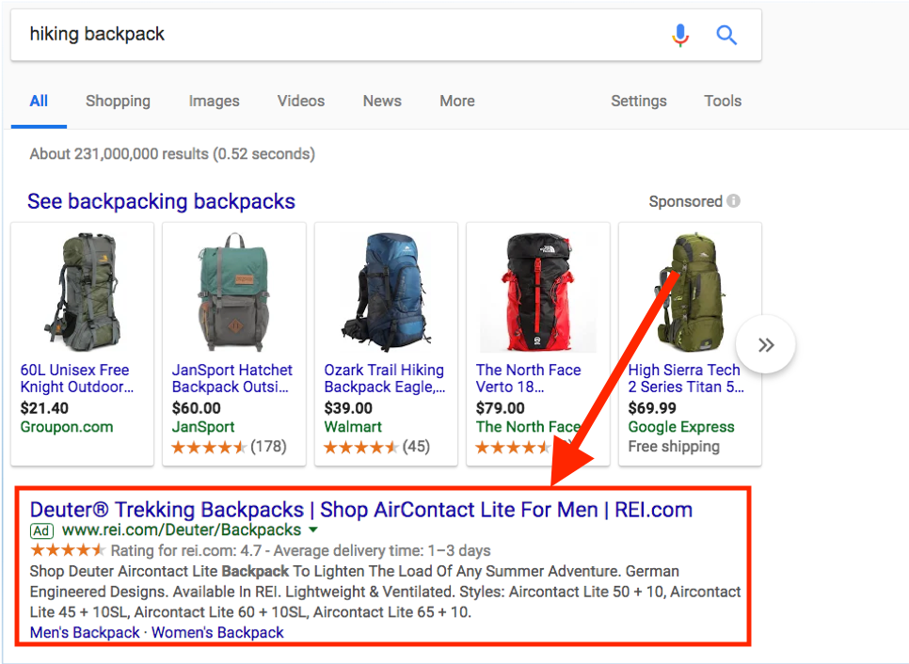
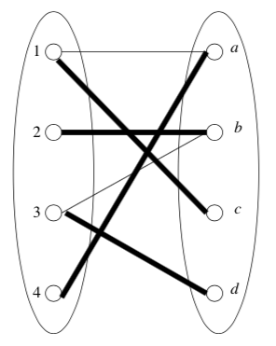
Allocation
Leskovec, Jure, Anand Rajaraman, and Jeffrey David Ullman. Mining of massive datasets. Cambridge University Press, 2014.

Slide 7
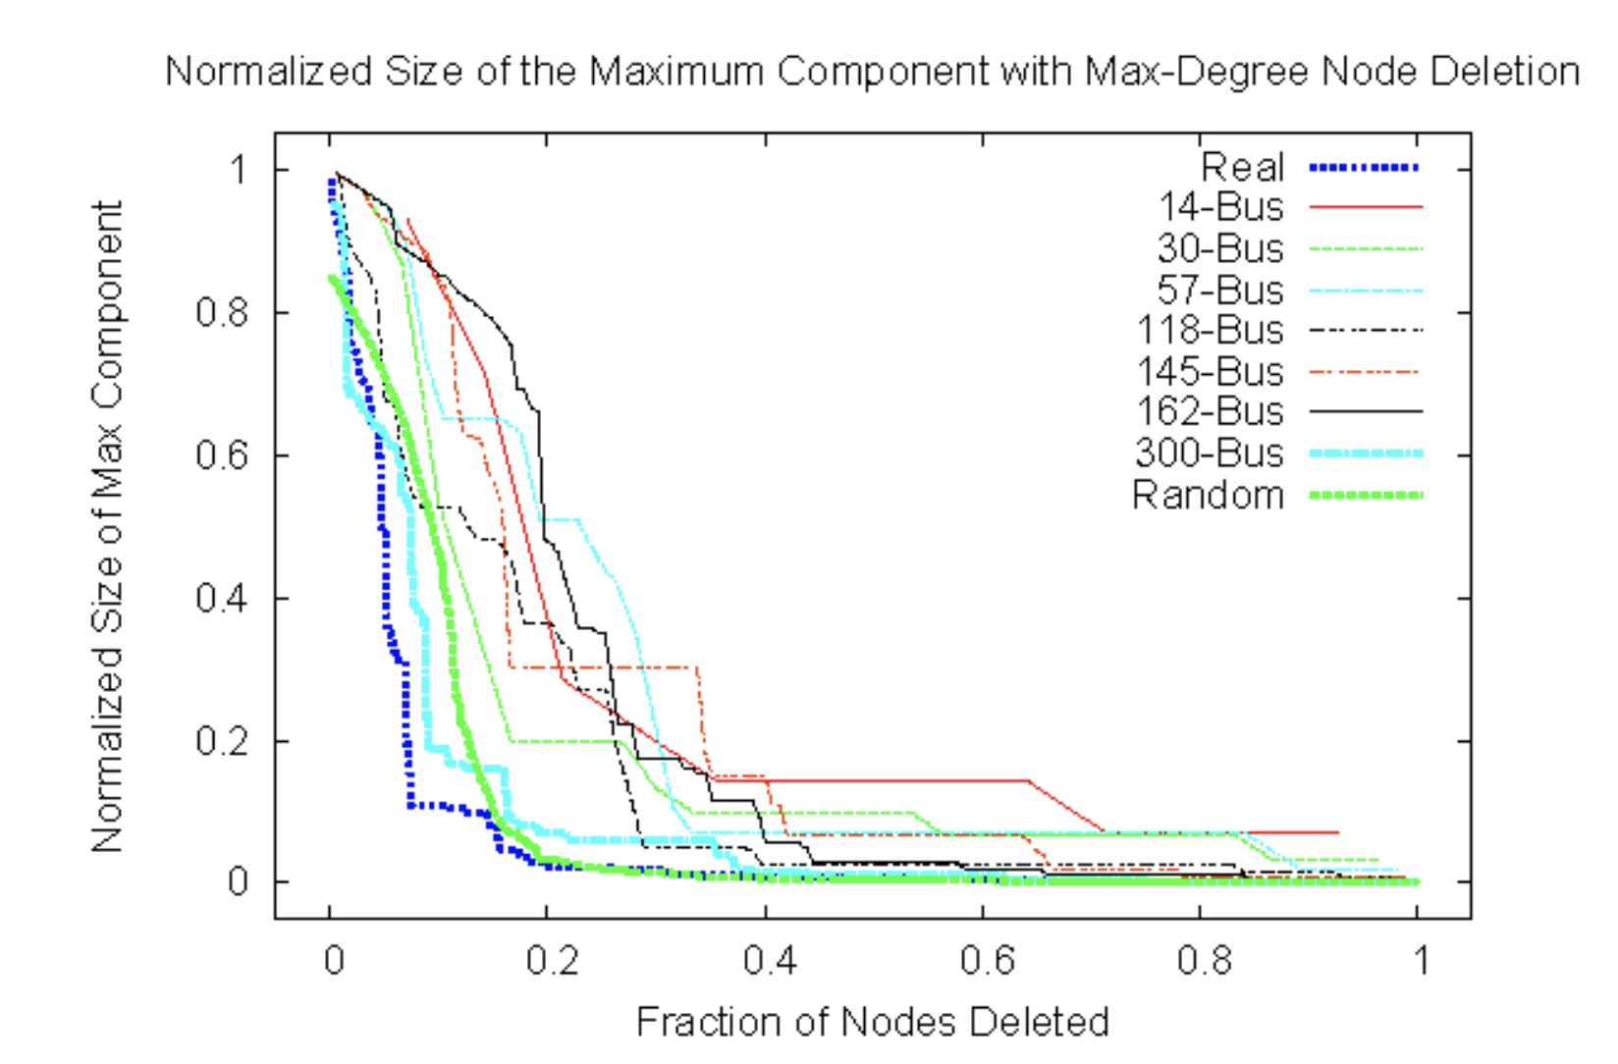
Infrastructure
Atkins, Karla, et al. "The structure of electrical networks: a graph theory based analysis." Int. J. Critical Infrastructures 5.3 (2009): 265-284.

Slide 8
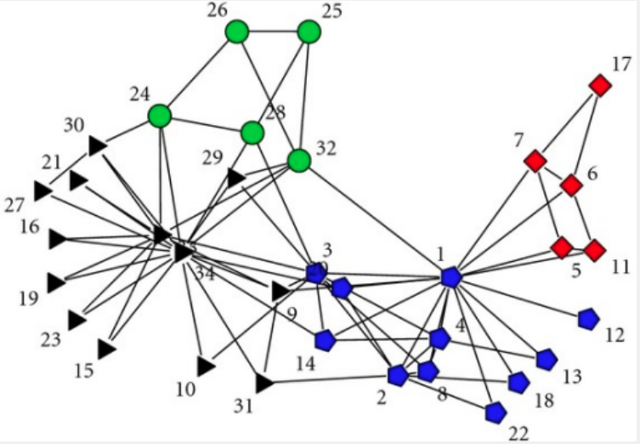
Social networks: communities
Zachary karate club network dataset -- KONECT, April 2017.

Slide 9
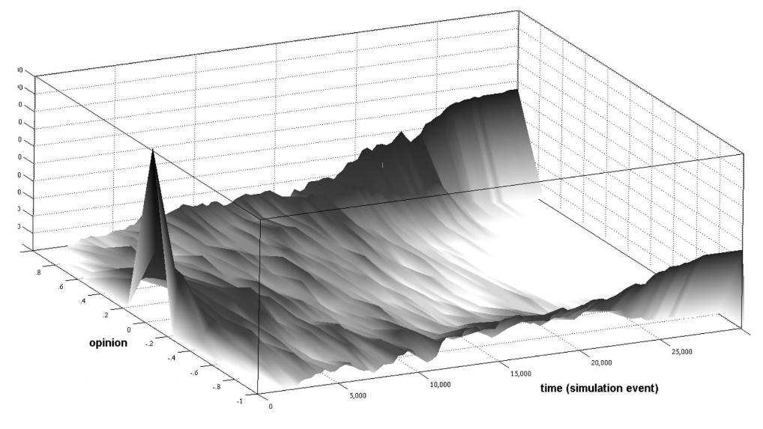
Social networks: polarization
Garimella, Morales, et al, KDD’18.

Slide 10
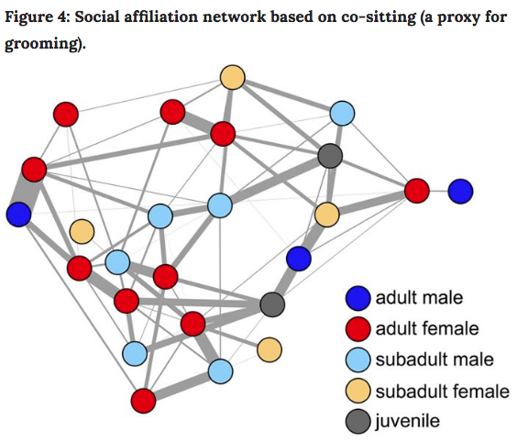
Behavioral ecology
Farine, Damien R., et al. "Both nearest neighbours and long-term affiliates predict individual locations during collective movement in wild baboons." Scientific reports 6 (2016): 27704

Slide 11
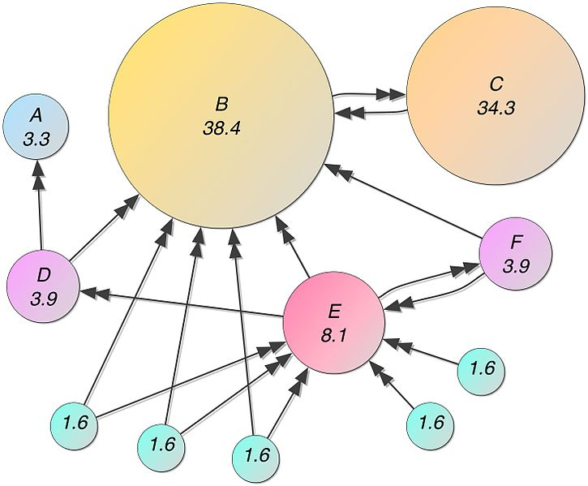
Web structure

Slide 12
Graph exploration :
Efficiently finding structure or knowledge in a graph, even if we don’t know exactly what we are looking for.
(Mottin and Müeller, KDD’18)

Slide 13
2.
Web graphs

Slide 14
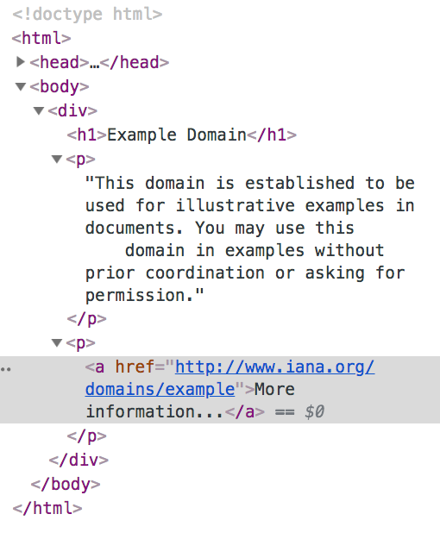
Web graphs: creation
Parent node: example.com
(directed edge)
Child node: iana.org

Slide 15
Web graphs: substructures
About
Homepage
Sports article
Sports page

Slide 16
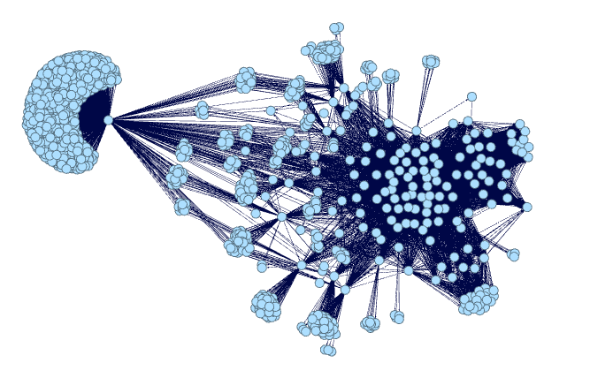
Web graphs: larger structures
Subpage structure of webpages in a news site, generated by me using Gephi.

Slide 17
Web graphs encode information about:
Communities
Content
Traffic

Slide 18
3. Spark

Slide 19
Graph Libraries
Tool | Graph size | is_python? | Visualization?
networkx | Single machine. | Yes. | Yes.
Gephi | Single machine. | No. | Yes.
Spark GraphFrames or GraphX | Multiple machines. | Yes. | Yes, plug in other libraries.
Apache Giraph | Multiple machines. | No. | No.
Neo4j | Multiple machines. | No. | Yes.
Bespoke solutions (here be dragons) | Many more machines. | ? | ?

Slide 20
Why choose GraphFrames?
Processes data too large to fit on single machine.
Provides parallelism in data input.
Provides parallelism in processing.
Has some fault tolerance.
Integrates nicely with other python packages.

Slide 21
What I did
Clean Common Crawl dataset. Select files, write custom parser for warc files, extract links from html.
Load graph into Graphframes.
Filter, clean, repeat. Do this, a lot.
Try to detect communities.

Slide 22
What I‘ll talk about
Clean Common Crawl dataset. Select files, write custom parser for warc files, extract links from html.
Load graph into Graphframes.
Filter, clean, repeat. Do this, a lot.
Try to detect communities.

Slide 23
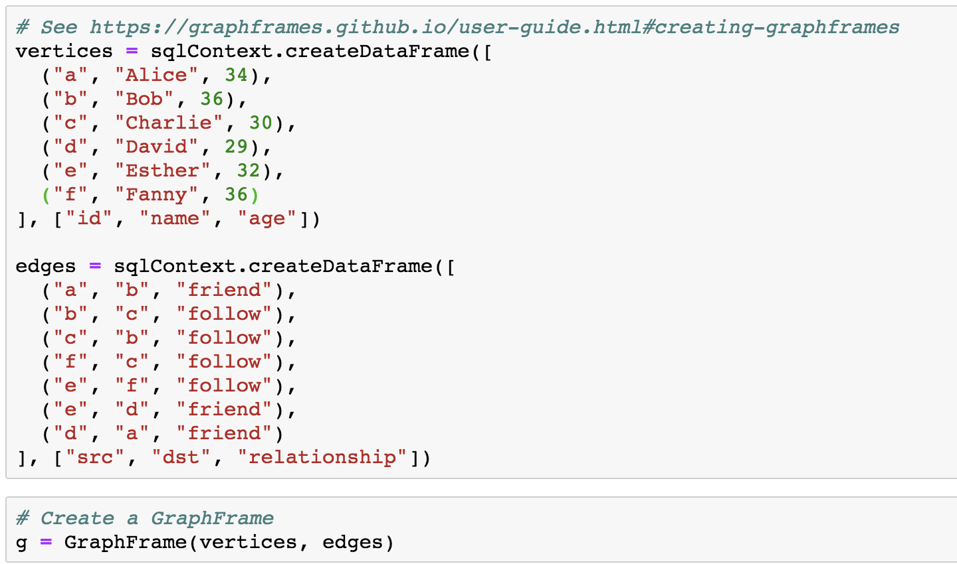
Create a GraphFrame

Slide 24
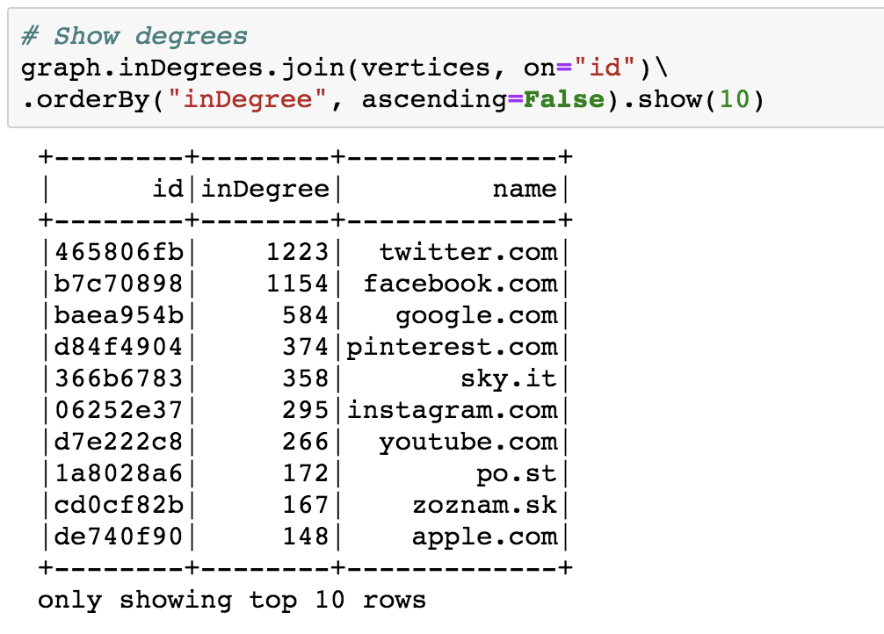
See top nodes

Slide 25
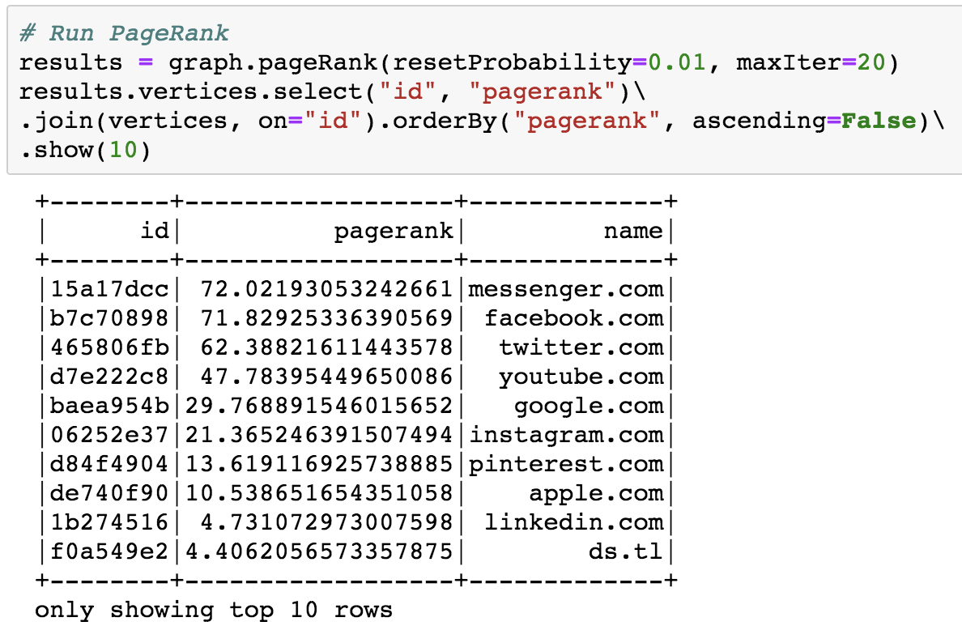
Run PageRank for fun

Slide 26
3. Community Detection

Slide 27
Advantages of Label Propagation Algorithm (LPA)
Labelled data is not required.
External parameter setting is nice, but not strictly necessary.
Runs in near linear time.
Raghavan, Usha Nandini, Réka Albert, and Soundar Kumara. "Near linear time algorithm to detect community structures in large-scale networks." Physical review E 76.3 (2007): 036106.

Slide 28
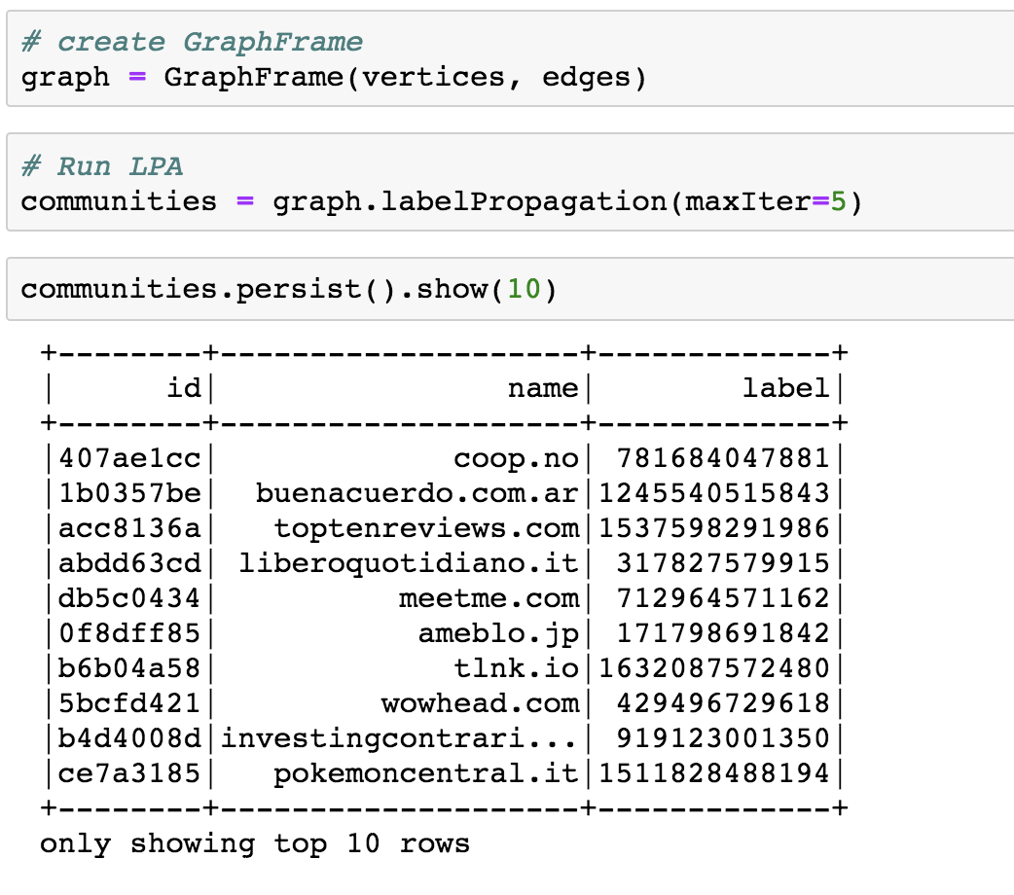
Run LPA

Slide 29
> 15 million
4,782
3,573 sites
That’s a lot of nodes. Filter, clean, repeat.
Communities detected
Size of largest community

Slide 30
Converges around 5-6 iterations for sampled Common Crawl data.

Slide 31
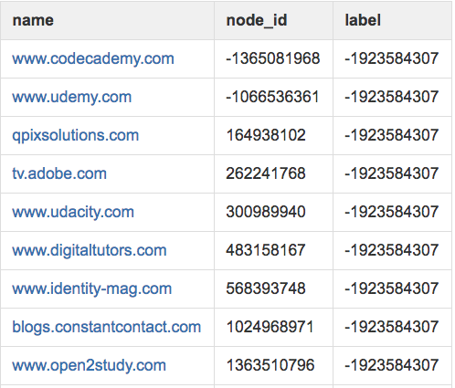
Community: online learning
Mixed community of online learning sites, sites that link to these sites .

Slide 32
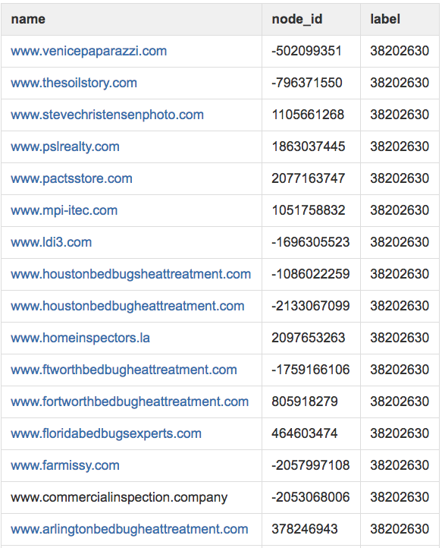
Community: bedbugs
Cookie cutter bedbug sites and sites with similar content resources.

Slide 33
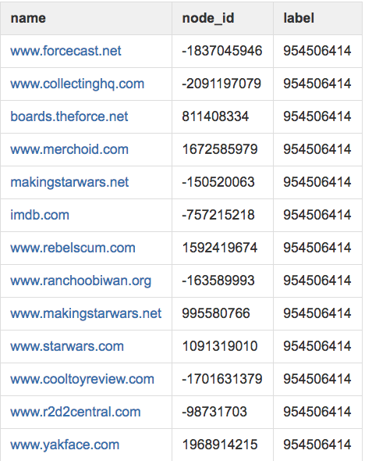
Community: fandoms
Sites related to Star Wars memorabilia.

Slide 34
Other avenues for exploration
Layering in edge attributes (link types, external metadata, etc).
Identify nodes of high centrality.
Observing how web graphs change over time.

Slide 35
The top of the iceberg is what talk is about
Didn’t talk about:
data parsing
inconclusive algorithms and results
trials and many, many errors ☺
See my Medium post (forthcoming) for more gory detail.

Slide 36
Obligatory Summary Slide
Graphs are powerful. Try them today!
Tool selection
Spark GraphFrames for handling large graphs
Community detection as form of graph mining

Slide 37
Thanks!
Find me at:
wsuen@appnexus.com
Repo:
Medium post:

